Slide 1
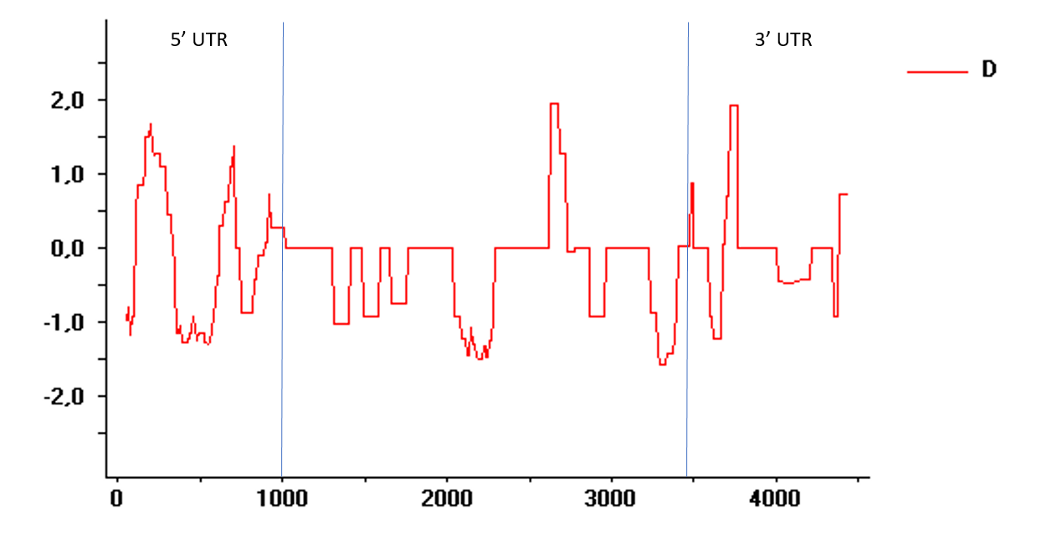
5’ UTR
3’ UTR
DHDPS Medtr1g088775
Tajima's D
Nucleotide Position

